Slide 1



Global Academy of Technology Rajarajeshwari Nagar,Bengaluru-560098
Department of Electronics and Communication Engineering
Seminar Presentation
(20ECS84)
on
“Design and Development of IoT-Based SmartTech-Agri Devices for Smart Agriculture Crop Field”
PRESENTED BY:
Name:LAVANYA S R
USN:1GA20EC081
Under The Guidance of:
Ms.KEERTHY N
Assistant proffesor,GAT.

Slide 2
CONTENTS
Abstract
Introduction
Proposed Methodology
Results and Discussion
Advantages and Applications
Conclusion
References

Slide 3
ABSTRACT
Internet of Things (IoT) technology adds new direction to the significant monitoring of soil, plants, and agriculture fields in smart agriculture. In this system, IoT- based solutions are employed to enhance the agricultural outcomes and resolve the different problems.
Here, an IoT- based device is proposed namely “SmartTech-Agri.” This device is designed to supervise the different parameters: soil moisture, air temperature, air humidity, smoke detection, and animal motion detection in the agricultural field.
Our pro- posed device uses a PIR motion sensor to detect movement of intruders, smoke sensor to detect smoke, soil moisture sensor to evaluate moisture percentage, and temperature– humidity sensor to measure environmental temperature in the agriculture field.
The proposed design consists of three main major portions: (a) an Arduino-based IoT gadget, (b) a Smartphone application, and (c) a Web server application.

Slide 4
INTRODUCTION
The project on the design and development of IoT-based smart tech-agri devices for smart agriculture crop fields aims to revolutionize traditional farming practices by harnessing the power of IoT technology.
By integrating sensors, connectivity, and data analytics, these innovative devices will enable farmers to monitor and manage their crops with unprecedented precision and efficiency.
The project seeks to address key challenges faced by modern agriculture, including resource optimization, environmental sustainability, and yield maximization, ultimately empowering farmers with actionable insights and decision support tools to enhance crop productivity and farm profitability in a rapidly evolving agricultural landscape.

Slide 5
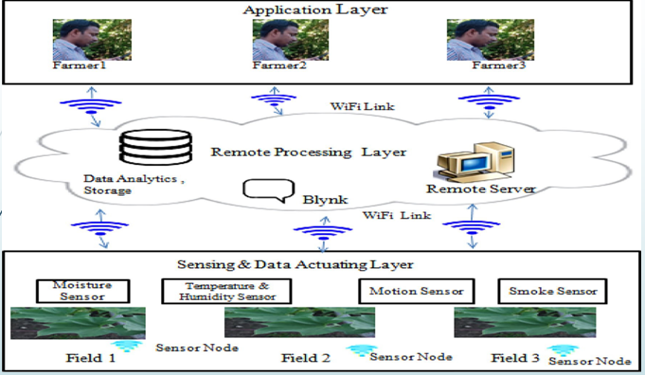
Proposed Methology

Slide 6
WORKING
Sensing and Data Actuating Layer :Wi-Fi technology is used by sensor nodes in the field to collect data about the field’s properties and transmit it to IoT gateway nodes. The data are then sent as packets by the gateway nodes to the distant server.
Remote Processing Layer :It is the middle layer between the bottom layer and upper layer. Smart technology organization processes requests as well as data from the top and bottom layer. The advantage of being able to oversee field operations from a distance is made possible by the remote processing layer.
Application Layer :The farmers may easily utilize the analytics to visualize the data that has been collected on their smart phones and personnel computers (PCs) with the aid of an internet and Wi-Fi connection. The farmers can locate a specific node’s position. Additionally, farmers can view their field data at any time via the Web server utilizing the Internet.

Slide 7
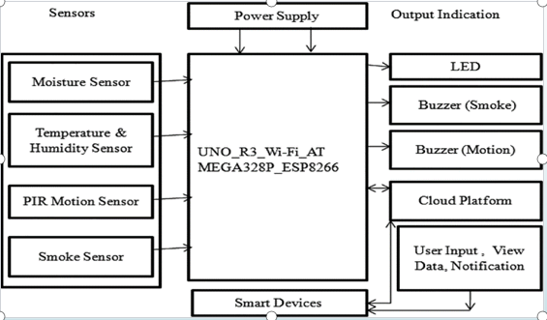
BLOCK DIAGRAM

Slide 8
Moisture Sensor (REES52) :The resistance of the fork- shaped moisture sensor probe varies with soil moisture content and operates as a variable resistor (similar to a potentiometer). Soil conductivity and resistivity improve as soil moisture content increases. We can determine the soil moisture content by measuring the output voltage generated by the sensor in accordance with the resistance.
Smoke Sensor (MQ-2) :The smoke sensor can be used to detect flammable gas leakage and smoke. All the measuring parameters of this sensor can be measured from the datasheet
Temperature and Humidity Sensor (DTH11) :This is a low-cost digital temperature–humidity sensor which computes the temperature and humidity in soil and environment.
Motion Sensor (PIR): The motion sensor (PIR) detects the movement of a human or animal within a range of around 10 m across the sensor placed in the agriculture field. This PIR sensor is capable of detecting different infrared radiation levels.
Integrated Design of IoT Gateway :It serves as a communication bridge by establishing connections between the sensors and other devices like Wi-Fi, Bluetooth, etc.
Integrated Design of Remote Servers: We have created a Web server as part of our design. The files that make up a website are kept on the Web server along with the web server software. The servers are kept in a cloud- based environment.

Slide 9
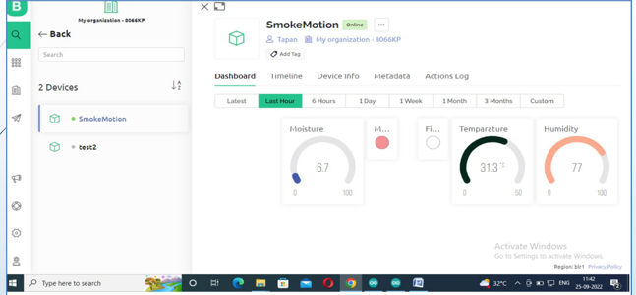
RESULT
visualisation of sensed data display on user web application

Slide 10
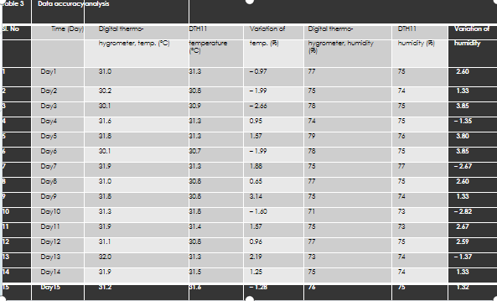
DATA ACCURACY ANALYSIS

Slide 11
1. ADVANTAGES
Precision Farming
Remote Monitoring
Data-driven Decision Making
Resource Efficiency
Automation
2. DISADVANTAGES
Initial coast
Complexity
Data Security

Slide 12
APPLICATIONS
Smart Irrigation
Crop Monitoring
Pest Control
Weather Forecasting
Resource Management
Remote Monitoring

Slide 13
CONCLUSION
The conclusion of designing and developing IoT-based smart agricultural devices for crop fields involves highlighting the achieved objectives, summarizing the key findings, discussing any challenges faced during the process, and outlining future directions for improvement and expansion. It should emphasize the potential benefits of the technology in enhancing crop yield, optimizing resource utilization, and facilitating sustainable farming practices. Additionally, it's essential to address scalability, compatibility with existing agricultural systems, and considerations for widespread adoption.

Slide 14
REFERENCES
G.S. Malhi, M. Kaur, P. Kaushik, Impact of climate change on agriculture and its mitigation strategies: a review. Sustainability 13(3), 1318 (2021).
C.A. Hernández-Morales, J.M. Luna-Rivera, R. Perez-Jimenez, Design and deployment of a practical IoT-based monitoring sys- tem for protected cultivations. Comput. Commun. 186, 51–64 (2022).
S.K. Roy, S. Misra, N.S. Raghuwanshi, S.K. Das, AgriSens: IoT- based dynamic irrigation scheduling system for water manage- ment of irrigated crops. IEEE Internet Things J. 8(6), 5023–5030 (2020).
S. Abba, J. Wadumi Namkusong, J.A. Lee, M. Liz Crespo, Design and performance evaluation of a low-cost autonomous sensor interface for a smart IoT-based irrigation monitoring and control system. Sensors 19(17), 3643 (2019).
P. Sarwade, N. Shinde, S. Tingre, FPGA based real time monitor- ing system for agricultural field. Int. J. Adv. Res. Innov Ideas Educ 3, 2766–2774 (2017).

Slide 15
THANK YOU

